Slide 1

PARKS & RECREATION UPDATE
ANNE LANE, PARKS & RECREATION DIRECTOR
Annual Town Meeting 2/12/2022

Slide 2
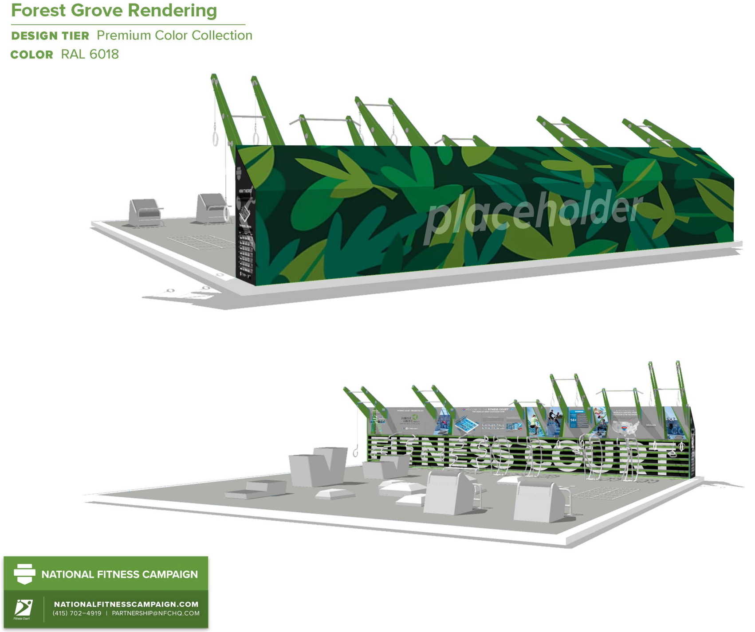


Slide 3
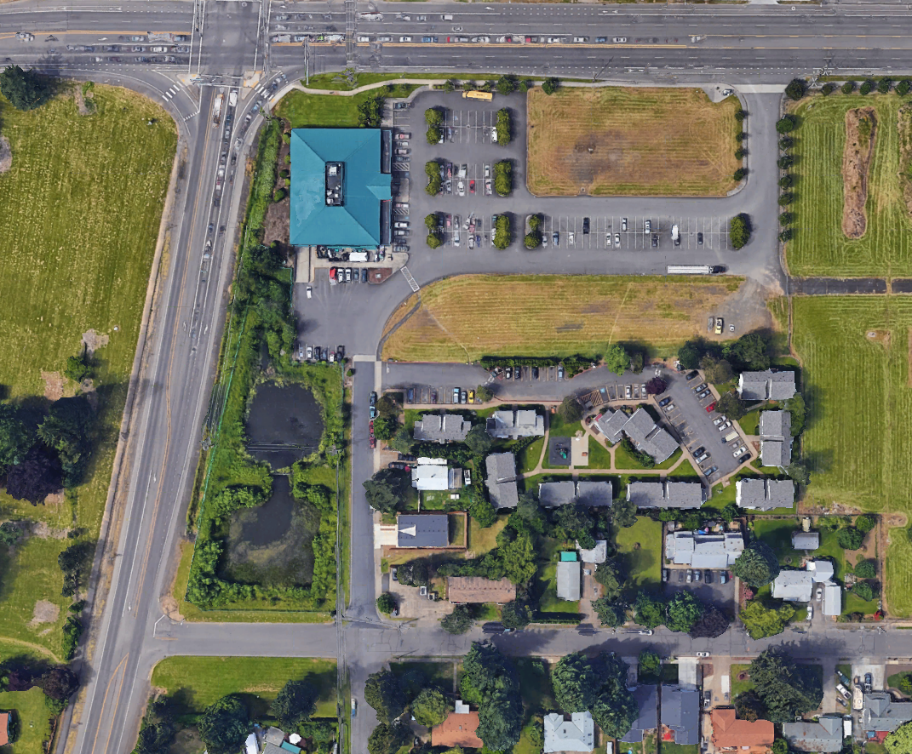

Slide 4
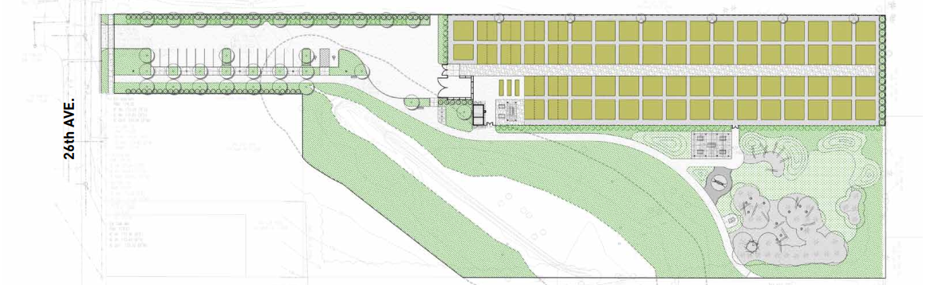
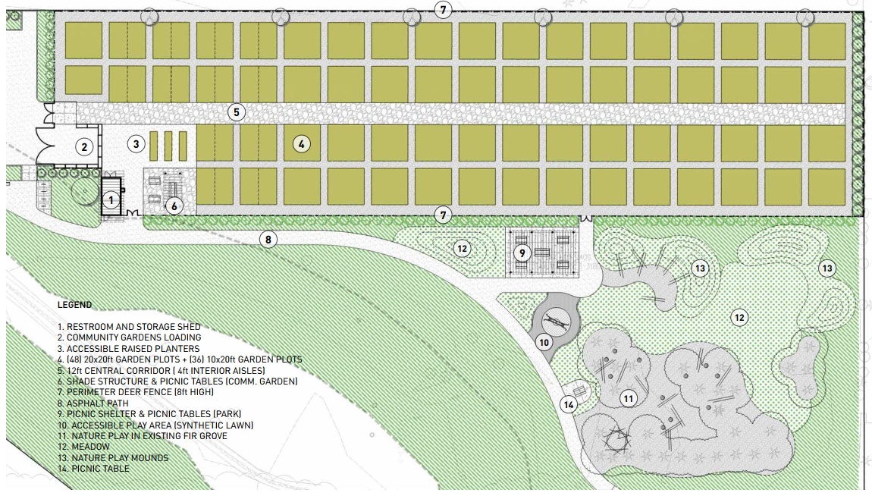

Slide 5
